Slide 1
Forex Prediction Through News Article Sentiment Analysis and Economic Indicators
Amy Fang, Annie Wang, Ian Lee, Daniel Da
CIS 5190

Slide 2
Agenda
Goal and Motivation
Past Work and Background
Contributions: Data and Application
Methodology
Summary of Results
Ethical Considerations and Next Steps

Slide 3
Goal and Motivation
Exchange rates prediction could impact both individual traders and broader financial market
Improve upon current research that relies on historical data or sentiment analysis in isolation
Leverage Long Short-Term Memory (LSTM) that encompasses a holistic framework of input sources covering 4 major areas
Add a main point
Model Inputs:
Add a main point
Add a main point
Add a main point
01
02
03
04
Historical Exchange Rates
WSJ News Articles and
Reddit Posts/Comments
Google Trends Search Terms Data
Economic Indicators
Model Output: Foreign exchange rate between US Dollar(USD) and Chinese Yuan (CNY)
Elaborate on what
you want to discuss.
Elaborate on what
you want to discuss.

Slide 4
Past Work and Background
Machine learning methods have been widely used for predicting financial indicators:
Rojas, Herman 2018: forecasted forex rate between US dollar and Mexican Peso using market features and fundamental variables
Olaiyapo 2024: utilized sentiment analysis from social media and news for USD forecasting
Masuda, Takeda 2019: utilized Google Trends search popularity data to predict exchange rates
Building on these prior works and following their directions for future improvements, we propose a new model using LSTM while combining both the market data and sentiment analysis from news and social media.

Slide 5

Contributions
Data
Application
WSJ Scraping and Analysis: FinBERT
Scraping contents from WSJ articles
Sentiment analysis using FinBERT
three probabilities: negative, neutral, and positive
aggregated the data by day and used a moving exponential average to impute data
Reddit Sentiment Analysis: VADER
Raw post and comment data from Reddit
Direct and informal representation of public sentiment
VADER: pre-built lexicon that is tailored to analyze sentiments in social media texts
Google Trends Data Collection
A proxy for internet search query volume data
Selected relevant search terms to capture the Purchasing Power Parity(PPP), money demand and money supply
Applying LSTM to a new domain
More areas than traditional approaches
Historical exchange rates, sentiment analysis, economic indicators, and Google search popularity on terms critical for impacting exchange rates
Comparing and evaluating the performance of LSTM
Baseline Model: only takes in historical exchange rates as input
Proposed Model: takes in data combining four categories of input
Elaborate on the featured statistic.

Slide 6
04
Methodology

Slide 7
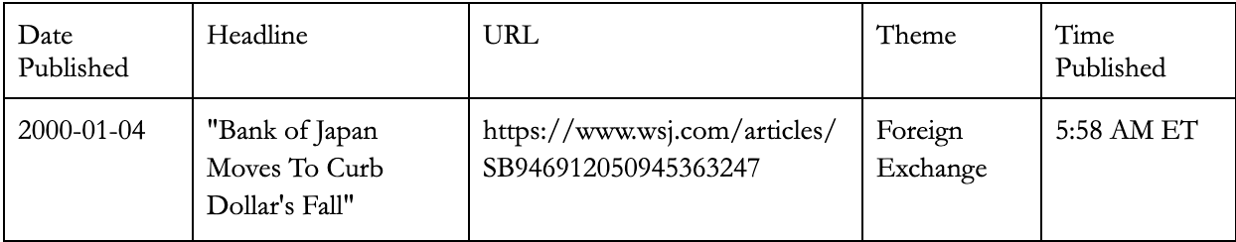
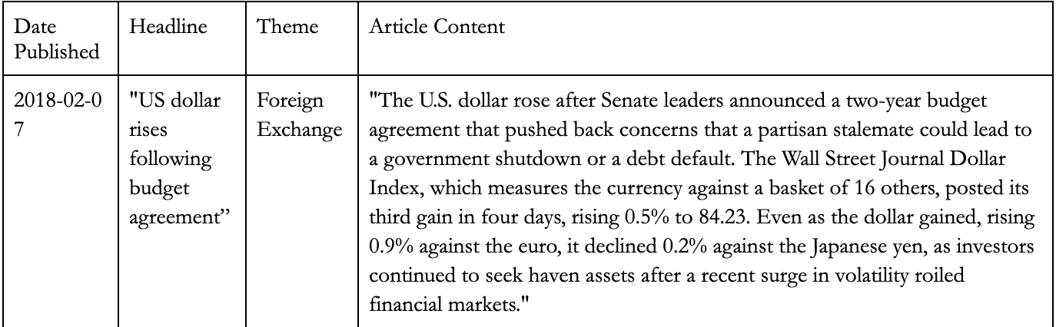
Data Scraping

Slide 8
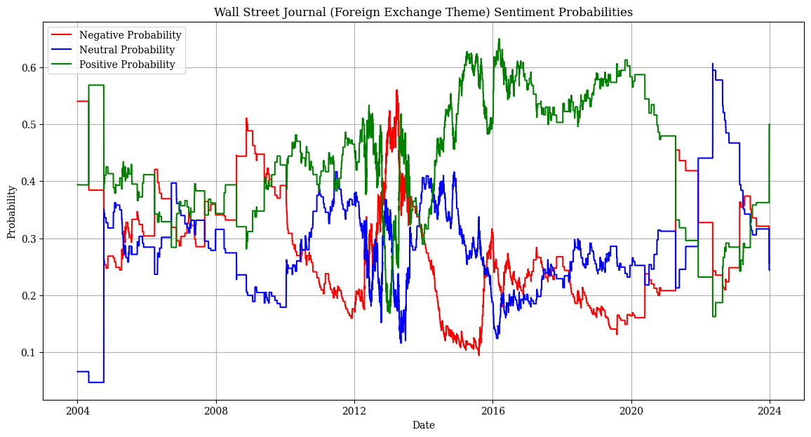
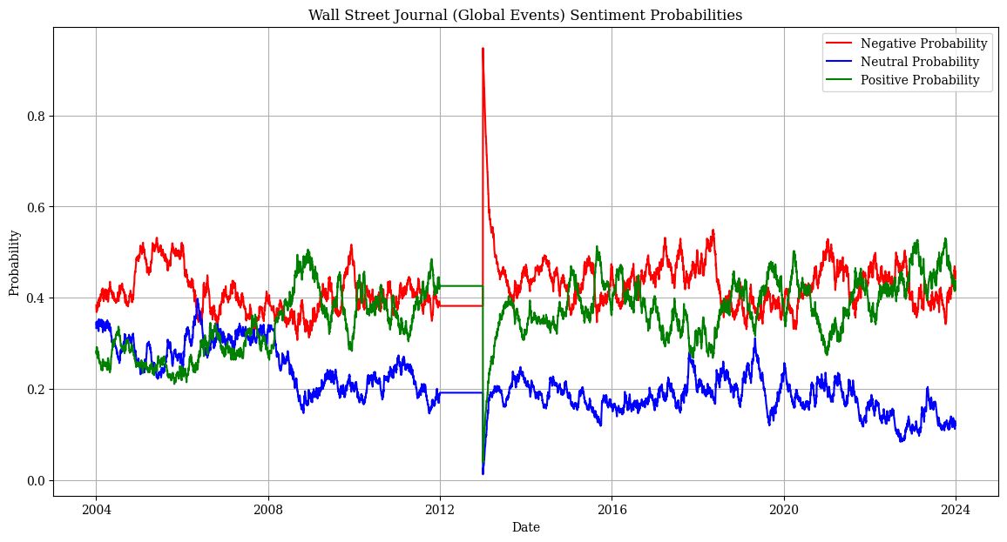
WSJ Sentiment Analysis - FinBERT

Slide 9
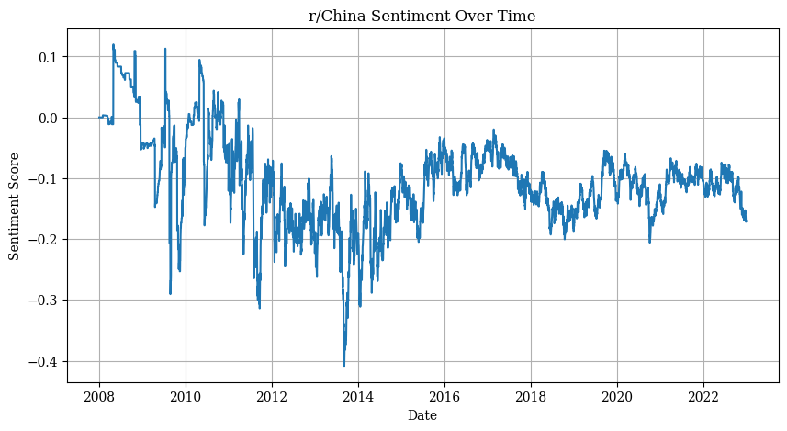
Reddit Sentiment Analysis - VADER

Slide 10
Google Trends Data
Data Acquisition:
‘Pytrends’ and Google Trends API
Monthly level data from 2004-2024
Daily data over 90 days intervals
Overlapping periods to deduce normalized daily data
Search Terms Selection
Purchase Power Parity (PPP)
Money supply and money demand
Price-related | Inflation, Prices, CPI, Cheap
Income-related | Buy, Spend, Save, Donate, Job, Vacation, Foreclosure
Liquidity-related | Cash, Credit, ATM

Slide 11
Economic Indicator Data
Interest Rates
Sources:
U.S. Bureau of Economic Analysis (BEA)
The Federal Reserve Bank of St. Louis (FRED)
U.S. Bureau of Labor Statistics (BLS)
U.S. Department of the Treasury
The National Bureau of Statistics of China
Trading Economics
U.S.
GDP
Unemployment Rate
China
Inflation Rate
Public Debt

Slide 12
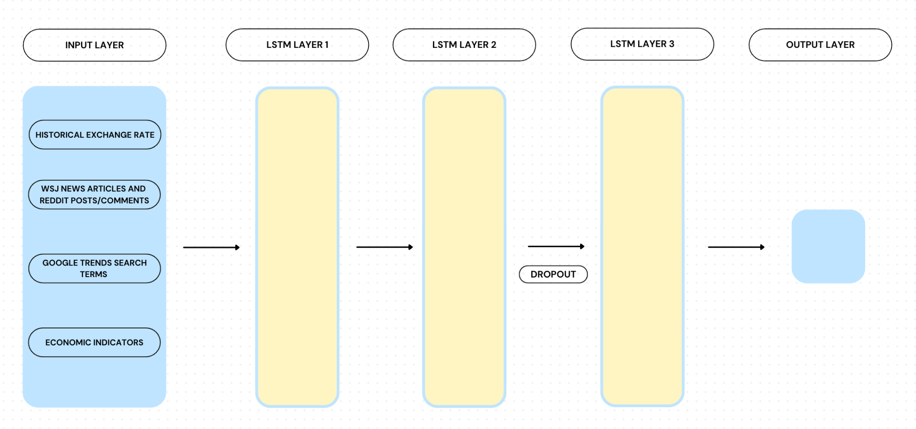
Model Architecture

Slide 13
05
Results

Slide 14
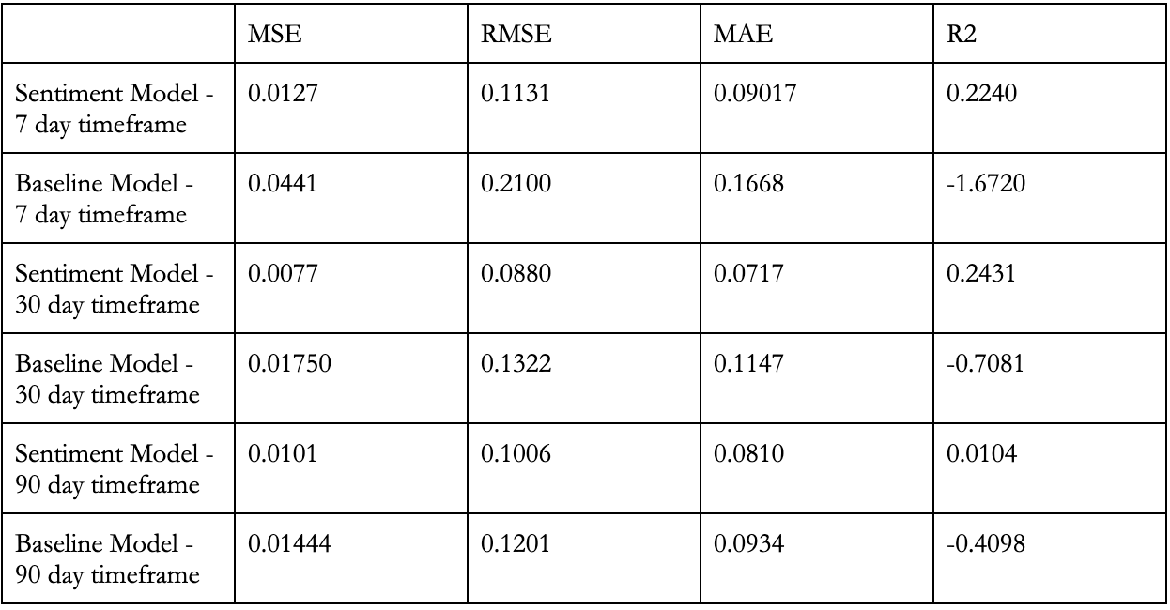
Results
Our model with the dataset of all 4 categories outperforms the baseline model that does not implement sentiment analysis of natural language data

Slide 15
Ethical Considerations & Next Steps
Data Privacy and Rights:
Social media (Reddit) scraping needs to maintain privacy of users
WSJ prohibits automated scraping of their content and has strict intellectual property rights
Expanding Goals of the Model:
Utilizing more natural language data
Predicting forex rates of other countries
Predicting other financial instruments (stocks, bonds, commodities)

